Slide 1
How Parents/Guardians Can Gain Understanding and Build Their Child’s Executive Functioning Skills
Debra Gately, Assistant Director for Special Education, K-8
Christine Panarese, Assistant Director for Special Education, K-8
September 26, 2019

Slide 2
Insert professional image of presenter
Debra Gately
Assistant Director of Special Education, K-8
Christine Panarese
Assistant Director of Special Education, K-8
CC-BY-NC Boston Public Schools | www.bostonpublicschools.org

Slide 3
Agenda for the Scope of Our Learning
Introductions
Workshop Learning Objectives
Definition, development timeline and interventions for recognizing weaknesses in your child’s executive functioning skills
What are the factors that impact the development of your child’s executive functioning skills
Examine the evidenced-based Open Resources that are available to help your child build stronger executive functioning skills

Slide 4
Executive Functioning Skills Defined

Slide 5
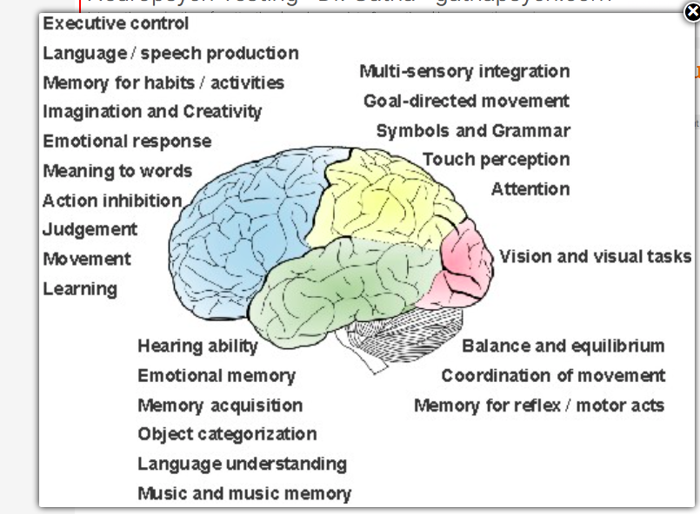
Mind/Brain EF Relation

Slide 6
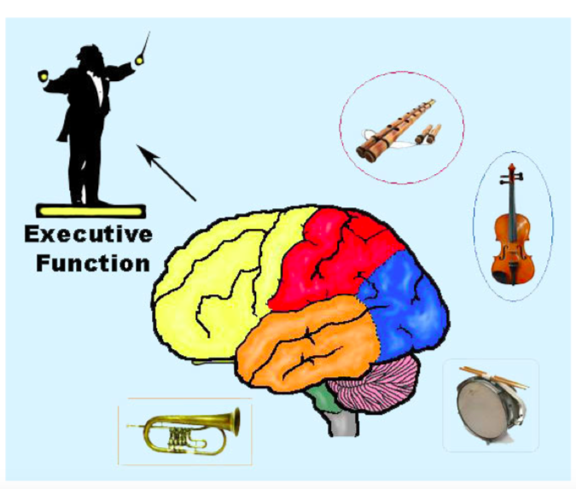
The Conductor
Functioning Skills
“The Conductor”Functioning Skills
“The Conductor”
Planning
Time management Sustained attention Organization
Working Memory Inhibition
Shifting
Goal-Directed persistence
Planning
Time management Sustained attention Organization
Working Memory Inhibition
Shifting
Goal-Directed persistence
adapted from greenwich.K12.ct

Slide 7
Executive Functioning Defined (understood.org)
Executive Function is a set of mental processes that helps to connect an individual’s past experience with their present action.

Slide 8
Executive Function Defined (www.uhs.wisc.edu)
Executive Function Skills are a set of skills for:
Self-management and exerting mental control and self-regulation.
Focusing, paying attention,
Organizing, starting and finishing schoolwork, flexible problem solving, and prioritizing.”

Slide 9
Children with Well Developed Executive Functioning Skills
They are able to:
make plans and initiate the first step.
Keep track of time and finish work on time.
Keep track of more than one thing at once.
Meaningfully include past knowledge in discussions.
Evaluate ideas and reflect on their work.
Ask for help or seek more information when they need it.
Engage in group dynamics.
Wait to speak until they’re called on.
Make mid-course corrections while thinking, speaking, reading and writing.

Slide 10
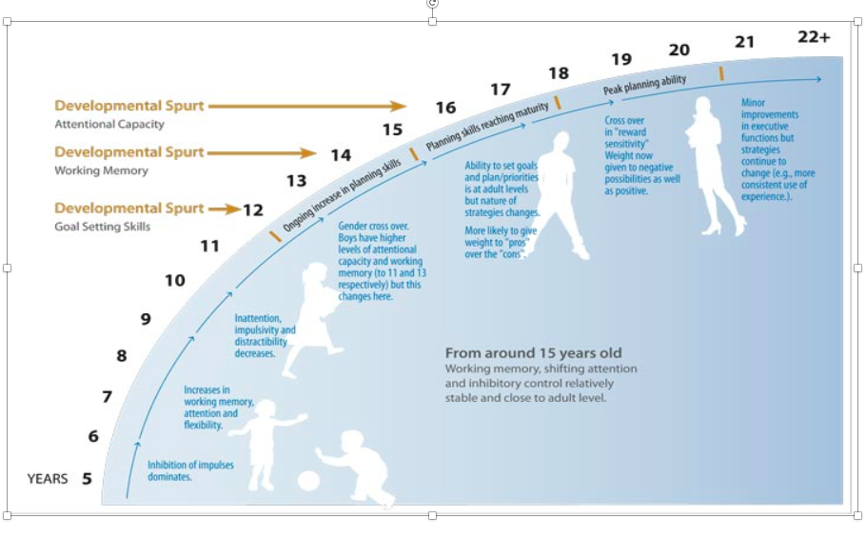
Executive Functioning Development Chart
Graphic found - rainbowrehab.com

Slide 11
Strategies for Building Planning Skills
Provide step-by-step visual directions and instructions.
Explicitly teach students how to “select” and use graphic organizers & templates.
Model planning by verbalizing your own thought processes. Teach students the difference between “short” and “long” term goals and have them practice selecting and writing after given a performance prompt.
Build student schema to support students in making connections.
Turn rubrics into checklists for feedback, self-monitoring, focus and progress.

Slide 12
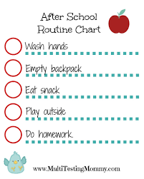
Sample Organization Charts

Slide 13
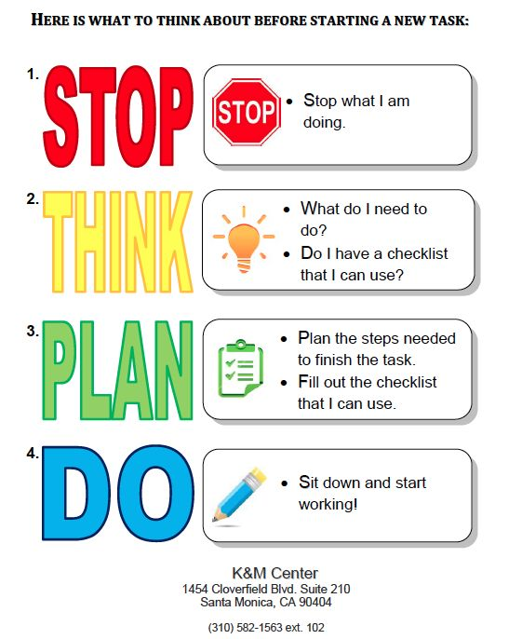

Slide 14
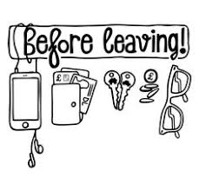
StickerArtDecor.com
Wall Stencil

Slide 15
Cognitive Flexibility - Higher Order Processes
COGNITIVE FLEXIBILITY DEFINED:
The brain’s ability to shift from a single idea, thought, activity or perception and allow another way for looking at things.
(Adapted from https://www.cde.state.co.us/facilityschools/facschools_ef_201)

Slide 16
Cognitive Flexibility Strategies
Evaluate assignments, worksheets and tests for too many “shifts” in the type of questions the student is required to answer. Reduce the different types of questions or help support students verbally as they are required to change/shift.
Teach coping strategies - teach a process for encountering the “full barrel” and use social stories to help teach solutions or coping strategies for different situations.
Structure group work to help identify, practice and learn flexible coping and problem solving strategies encountered.
Teach students how to stop the “cycle” of thought, relaxation or coping strategies
(mindfulness, deep breaths, calming self-talk, leaving the situation until calm, etc.).
Help students understand why strategies used in one setting or for one task may not work for another by role-playing/modeling how to generate more than one outcome and more than one potential solution.

Slide 17
How Do We Teach Our Children to Fail Well
Growth Mindset
Error Analysis
Deconstructing Poor Choices
Self-Reflection

Slide 18
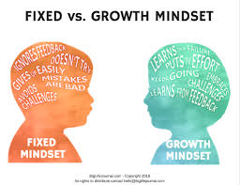
Shifting from a Fixed to a Growth Mindset

Slide 19
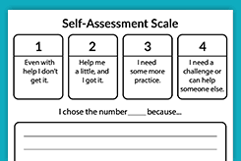
Example (teachervision.com)

Slide 20
Other Resources
Please be sure to take home the package of resources prepared for this presentation.
Thank you!

